Slide 1


DIGITAL IMAGE PROCESSING
PRESENTED BY
P.RAJESH
K.VISHNUPRIYA

Slide 2


Slide 3

CONTENTS
Introduction
Image
Types Of Digital Images
Levels of DIP
History
Why DIP ?
Basic Operations
Histogram
Block Diagram
Noise –Types-Removal Methods
Information Hiding
Applications and Software tools

Slide 4

DIP
Digital image processing can be defined as processing of digital image using computer algorithms.
It involves :
Improvement of pictorial information
Processing of image data and representation for autonomous machine perception

Slide 5
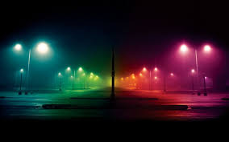
IMAGE
2D light intensity function f(x,y)
Considered as Matrix
Described in both spatial coordinates and brightness
The point in the image and element value identifies grey level
f(x,y)=R(x,y)*I(x,y)
Pixels or pels

Slide 6

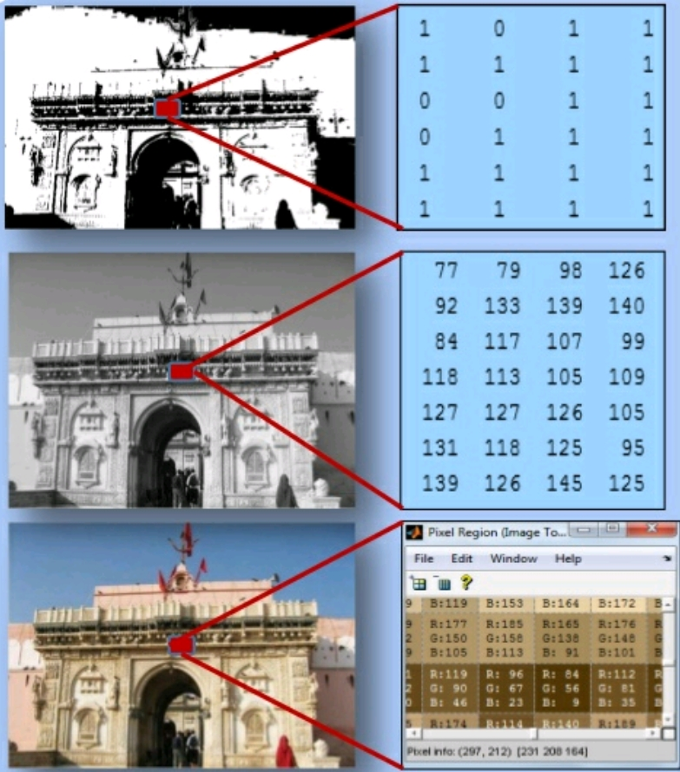
Types of digital images
Binary image
Gray scale image
Color image or
RGB image

Slide 7

LEVELS OF DIP
Low level INPUT: Image OUTPUT: Image Ex: Noise removal, Image sharpening | Mid level INPUT: image OUTPUT: Attributes Ex: Object recognition, segmentation | High level INPUT: Attributes OUTPUT: understanding Ex: Scene understanding, Autonomous navigation

Slide 8


Let’s look back !
When the digital image processing started ?

Slide 9

HISTORY
1920- Bartlane cable picture transmission service
1921- photographic printing
1964- improve the pictures of moon transmitted by RANGER 7

Slide 10

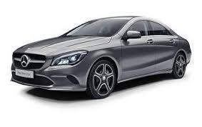
Why Digital Image Processing ?
Reduces size
Compression ( Removing Redundancies )
Minimum bandwidth
Image Enhancement
Original Image Compressed Image Compressed Image
Size – 116 KB Size – 12.9 KB, 11 % Size – 1.95 KB, 1.6 %

Slide 11

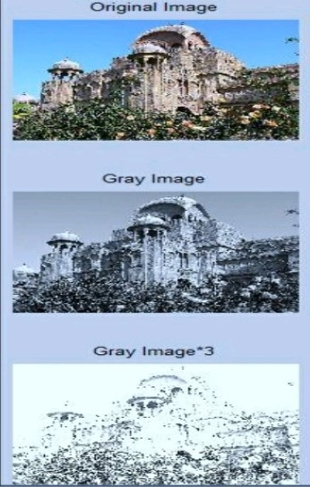
Basics operations with image
Say image as y=f(x)
Add or subtract or multiply
or divide each pixel value by
constant factor C
Y=f(x)+C
Y=f(x)*C
Y=f(x)/C
complement-photographic negative
Logical operations AND, OR,
NOT in binary image

Slide 12
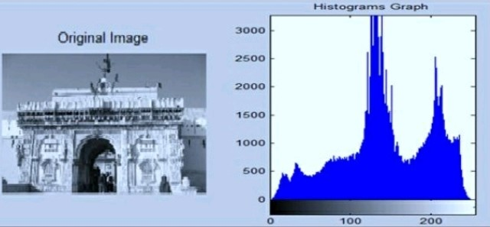
Histogram of image
Represents number of times each gray level occurs in the image
Dark image - gray levels will be clustered at lower end
Uniformly bright - gray levels will be clustered at upper end
Well contrasted- gray levels will spread out over much of range

Slide 13



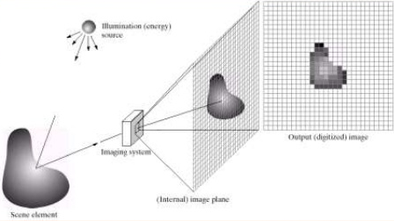
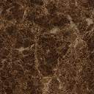
IMAGE ACQUISITION
Image Restoration
Morphological processing
Segmentation
Image Enhancement
Object
Recognition
Image Acquisition
Representation &
description
Colour Image Processing
Image Compression

Slide 14

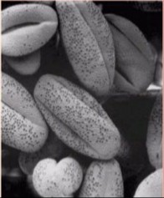
IMAGE ENHANCEMENT
Image Restoration
Morphological processing
Segmentation
Image Enhancement
Object
Recognition
Image Acquisition
Representation &
description
Colour Image Processing
Image Compression

Slide 15
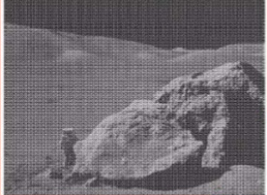
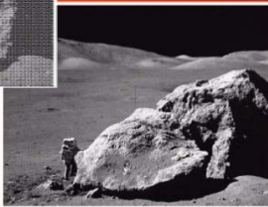
IMAGE RESTORATION
Image Restoration
Morphological processing
Segmentation
Image Enhancement
Object
Recognition
Image Acquisition
Representation &
description
Colour Image Processing
Image Compression

Slide 16
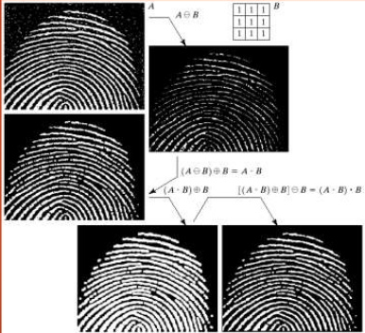
MORPHOLOGICAL PROCESSING
Image Restoration
Morphological processing
Segmentation
Image Enhancement
Object
Recognition
Image Acquisition
Representation &
description
Colour Image Processing
Image Compression

Slide 17
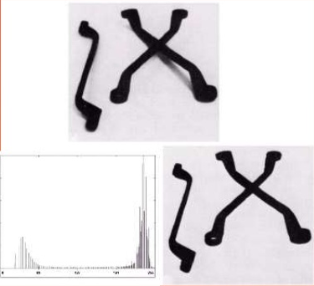
SEGMENTATION
Image Restoration
Morphological processing
Segmentation
Image Enhancement
Object
Recognition
Image Acquisition
Representation &
description
Colour Image Processing
Image Compression

Slide 18
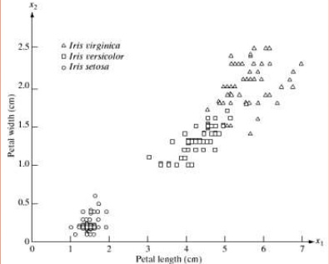
OBJECT RECOGNITION
Image Restoration
Morphological processing
Segmentation
Image Enhancement
Object
Recognition
Image Acquisition
Representation &
description
Colour Image Processing
Image Compression

Slide 19
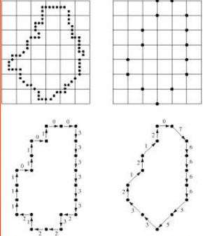
REPRESENTATION AND DESCRIPTION
Image Restoration
Morphological processing
Segmentation
Image Enhancement
Object
Recognition
Image Acquisition
Representation &
description
Colour Image Processing
Image Compression

Slide 20
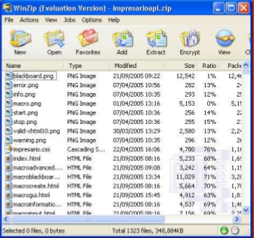
IMAGE COMPRESSION
Image Restoration
Morphological processing
Segmentation
Image Enhancement
Object
Recognition
Image Acquisition
Representation &
description
Colour Image Processing
Image Compression

Slide 21
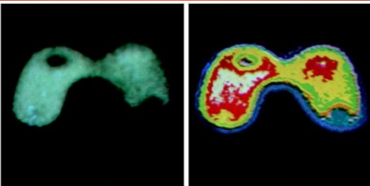
COLOUR IMAGE PROCESSING
Image Restoration
Morphological processing
Segmentation
Image Enhancement
Object
Recognition
Image Acquisition
Representation &
description
Colour Image Processing
Image Compression

Slide 22

NOISES
Salt and pepper noise : sharp and sudden disturbances
Gaussian noise : fluctuations
Speckle noise : degrades quality of active radar
Shot noise : dominant noise in the lighter parts of an image

Slide 23
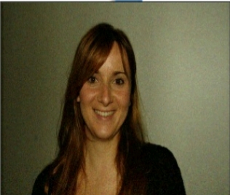

Noise extraction from image

Slide 24
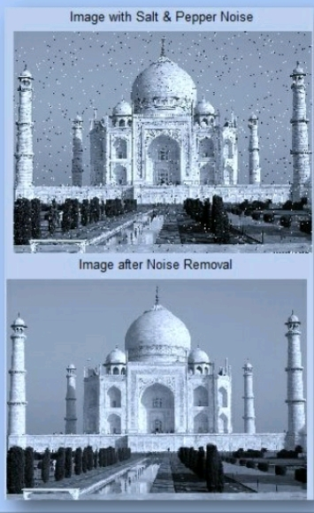
Removal of Noise
Linear filter
Median filter
Specific case of order statistic
filtering.
Remove salt & pepper noise.
Adaptive filter
Weiner filter
Removes Gaussian noise

Slide 25
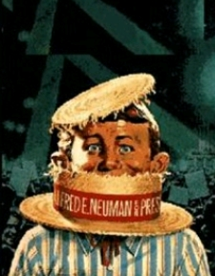
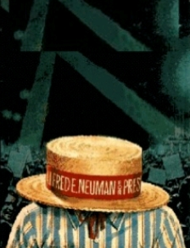
Information Hiding By Image Processing

Slide 26


Information Hiding By Image Processing
Steganography
Watermarking
DIP
ENCODER
DECODER
DIP

Slide 27

Applications of Digital Image Processing
Identification
Robot vision
steganography
Image Enhancement
Morphological Image Analysis
Space Image Analysis
Security checking - CCTV Images, Finger Print, vehicle number plate checking
IC Industry……..etc,

Slide 28




Popular Image Processing Software TOOLS
CVIP tools
Intel Open Computer Vision Library
Microsoft Vision SDL Library
MATLAB
KHOROUS

Slide 29


